Slide 1
Module 4.5:
Data Collection
Ethical Data Collection and Model Testing Regarding Human Subjects
ML for Cybersecurity

Slide 2
Adversaries
Ethics
Attacker’s goals
Attacker’s capabilities
Robustness of model/feature
Privacy
Fairness
Transparency
Modules 2 – 4
Module 4
Module 2
Module 1
Identify Goals & Collect Data
Data Representation
Modeling
Deployment
Pinpoint needs
Data acquisition
Data labeling
Data exploration
Data cleaning
Missing data
Feature selection
Consider fairness
Efficiency
Accuracy
Interpretability
Adversarial resistance
Performance
Evasion and attacks
Model drift
Impact on stakeholders
Module 3

Slide 3
Adversaries
Ethics
Attacker’s goals
Attacker’s capabilities
Robustness of model/feature
Privacy
Fairness
Transparency
Modules 2 – 4
Module 4
Module 2
Module 1
Identify Goals & Collect Data
Data Representation
Modeling
Deployment
Pinpoint needs
Data acquisition
Data labeling
Data exploration
Data cleaning
Missing data
Feature selection
Consider fairness
Efficiency
Accuracy
Interpretability
Adversarial resistance
Performance
Evasion and attacks
Model drift
Impact on stakeholders
Module 3

Slide 4
FAMOUS FAILURES

Slide 5
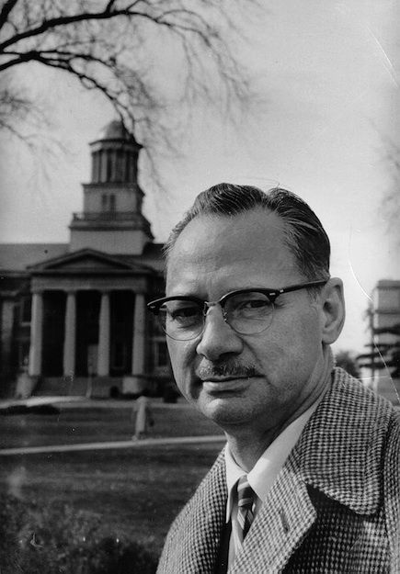
The Monster Study
University of Iowa, Wendell Johnson and Mary Tudor (1939)
Affirmation/criticism in speech therapy
Participants: 22 orphan children
Group 1: positive speech therapy / praise
Group 2: criticism for every imperfection
Children in the second group developed permanent speech issues

Slide 6

Tuskegee Syphilis Experiment
United States Public Health Service and Tuskegee University. Tuskegee Study of Untreated Syphilis in the Negro Male. 1932-1972
Participants: 600 impoverished, African-American sharecroppers
399 with syphilis, 201 without (control group)
Not told they had syphilis
Not treated with penicillin

Slide 7

Emotional Contagion Study
Adam D. I. Kramer, Jamie E. Guillory, and Jeffrey T. Hancock. Experimental evidence of massive-scale emotional contagion through social networks. PNAS 111(24):8788-8790, June 17, 2014
A friend expressing emotion can impact the emotion of someone else
Participants: 689,003 Facebook users
Varied emotional expressions in News Feed

Slide 8
Human Subjects

Slide 9
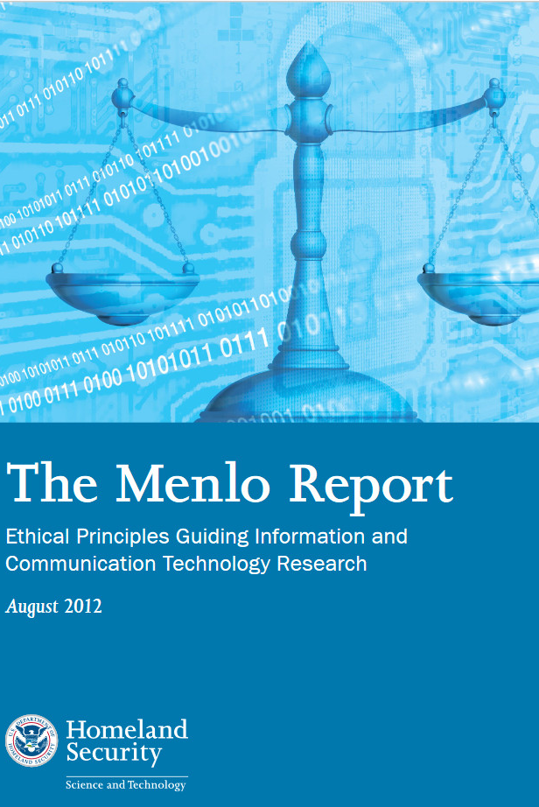
Protection of Human Subjects
Belmont Report (1978)
Respect for persons (informed consent)
Beneficence (maximize benefits vs. risks)
Justice (do not exploit / fair distribution)
Menlo Report (2012)
Respect for the law / public interest

Slide 10
Business Applications

Slide 11
Human-Subject Data for Cybersecurity ML
Do you need this data for your model?
How much do you actually need?
Do the data subjects know you are collecting this data?
Have they given meaningful, informed consent?
How, if at all, will the data subjects benefit? What about society?
What risks will the data subjects face from data collection or from the testing of your model?
Could a less invasive method provide equal insight?

